Slide 1
Hybrid Movie Recommender System
Zaid Ghazi
STAT 6309
2025

Slide 2
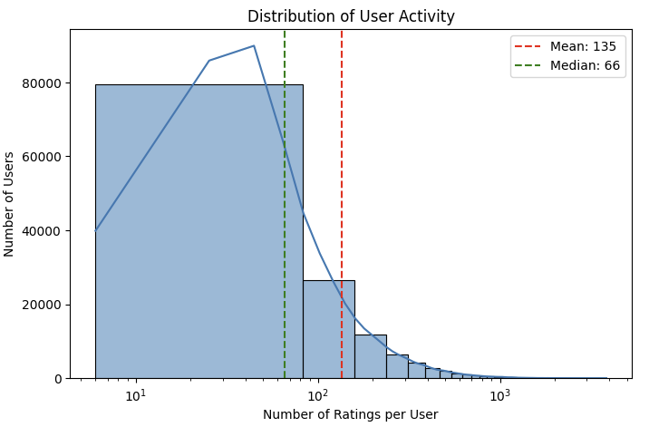
Data Preprocessing & Exploratory Analysis
MovieLens 20M
(≈ 20 million ratings, 138 000+ movies, 160 000+ users)
Cleaning steps:
Drop any rows missing userId or rating.
Fill missing tmdbId with −1; ensure tag_relevance and genres_list are non‑null lists .
Feature construction:
Exploded genome tags into per‑movie tag vectors.
Parsed genre strings into lists.
EDA highlights:
Most users rate few movies, tail of heavy raters .

Slide 3
Methods Overview
Popularity: Bayesian weighted score on train ratings.
Content-Based: Dot‑product of user’s averaged tag profile with each candidate’s tag vector.
Collaborative: Truncated SVD (10 components) → cosine similarity between user and movie embeddings.
Ensemble:
Take top 10 from each base model
Min–max normalize their scores
Sum normalized signals → final ranking

Slide 4
Evaluation Setup
Leave‑one‑out: hold one ‘liked’ (rating ≥ 4.5) movie per user as the ground‐truth.
Quick feedback: sample 500 users for fast iteration.
Parallel: Joblib Parallel(n_jobs=32, backend='threading') with batch_size=200 to avoid pickling overhead
Metrics:
HitRate@10: Did the model include the held‑out movie?
NDCG@10: How highly was it ranked?

Slide 5
Results
Best recovery: Collaborative (15.8 %)
Best ranking: Ensemble (NDCG 0.0842)
Model | HitRate@10 | NDCG@10
Popularity | 0.080 | 0.0515
Content‑Based | 0.110 | 0.0581
Collaborative | 0.158 | 0.0781
Ensemble | 0.150 | 0.0842

Slide 6
Interpretation & Takeaways
Coverage vs. precision:
Collaborative filtering → breadth of hits
Ensemble → tighter top‑10 (higher NDCG)
Fusion payoff:
Equal‑weight blending recovers nearly as many hits as collaborative alone while boosting ranking precision
Coverage vs. precision:
Collaborative filtering → breadth of hits
Ensemble → tighter top‑10 (higher NDCG)
Fusion payoff:
Equal‑weight blending recovers nearly as many hits as collaborative alone while boosting ranking precision

Slide 7
Limitations & Future Work
Scale evaluation to all 200 K users (currently sampled 500).
Hyperparameter tuning:
SVD dimensions, popularity cutoff (m), top‑k tags.
Learned weights: Replace equal‐weight sum with a trained meta‐model.
Side‐info enrichment: NLP on plots, director/actor features via streaming or sharding.
A/B testing: Deploy online to collect real engagement metrics.

Slide 8
Thank you
Zaid Ghazi

